Slide 1


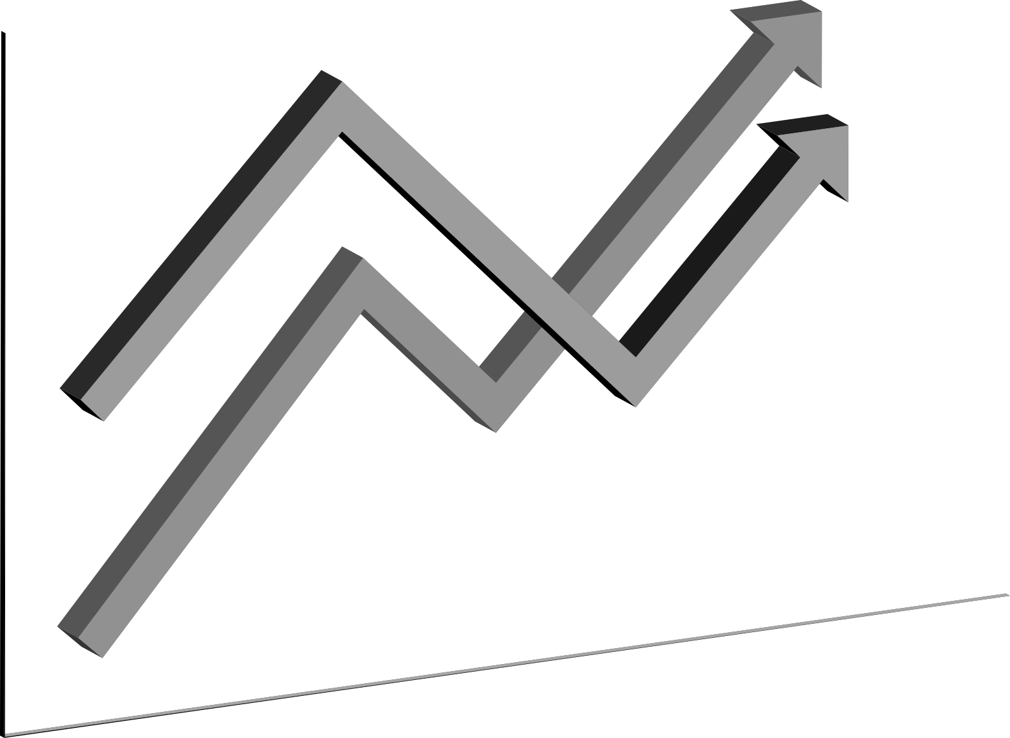
STRATEGIC PLAN
Datasets : All the three datasets will be used
Data preparation :
The data from the three tables must be merged into a single table
using an outer join on all of the tables
Feature Engineering :
For better analysis a new feature that maintains a record on when a
particular stock has been restocked, will be beneficial.
Model Experimentation:
We can train a model that predicts when a product is likely to run
out of stock and also which is the ideal temperature for certain products.
Evaluation:
The model must be evaluated using K-fold Cross validation which will
give us a better insight of the model
Deployment:
We can use cloud services to create an API for our model and ask the
Dev team to integrate our model in appropriate applications.

